Slide 1

5+ Years Experienced as a Software Engineer with a demonstrated history of working in Software industry.
Skilled in: Python3.x,C ++ 11/17,Bash,AWS /Azure( SaaS , paas) , Artificial intelligence ( 2D-image processing and 2D Computer vision), Algo , OOPS and multi-threading and multi-processing Application programing, Research and Development (R&D), CICD , Docker.
feel free to reachout:
Linkedin
twitter
Github.com

Slide 2

Microsoft azure Device Provisioning and connect a Device to Azure-iot-hub

Slide 3
Today agenda:
What is IOT devices?
Example of IOT devices.
What is Device Provisioning ?
Azure IOT-hub Device Provisioning service.

Slide 4
Prerequisite :
Python 3X and pip package.
SSH and OpenSSL basic.
Basic understanding of Cloud.
Basic Understanding of IOT.
Azure Cloud login credentials.

Slide 5
What is IOT devices:
The Internet of things(IOT) is a system of interrelated computing devices, mechanical and digital machines provided with unique identifiers and the ability to transfer data over a network without requiring human-to-human or human-to-computer interaction.

Slide 6

Example of IOT devices:

Slide 7
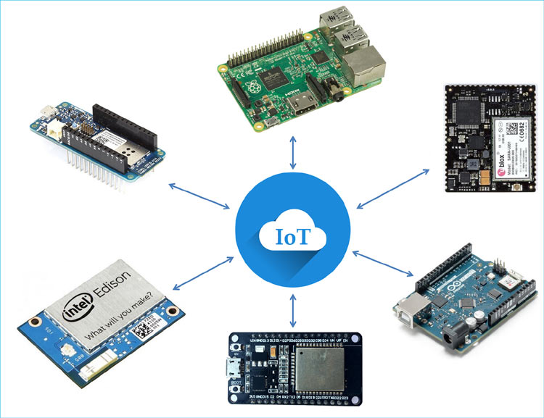
Real Device example:
There is many-many IOT device in market for example : NodeMCU , raspberry Pi3/4/ , Arduino/Nano etc.
You can choice a Device according to your usage.
Raspberry Pi3/4
Nano Arduino
Arduino
Node MCU

Slide 8
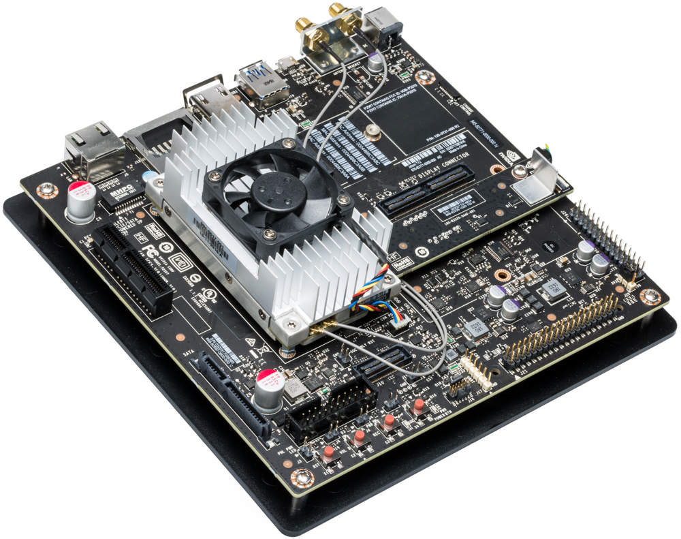
My Device:
NVIDIA Jetson TX2

Slide 9
Device Provisioning:
Device Provisioning (DPS) is a cloud-based service that helps IoT Devices to provide automatic provisioning features with no human intervention. DPS provides the ability to provision up to millions of IoT devices in a secure and scalable effort.

Slide 10
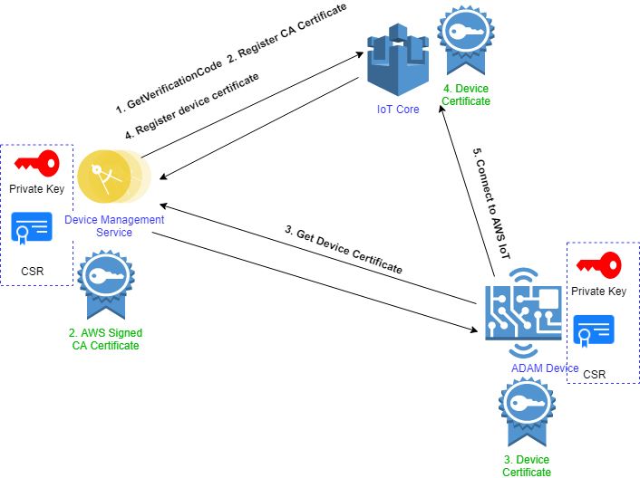
Authentication

Slide 11
Root CA Creation:
Install openssl tool for the Operating system and make sure that it is available in the command execution path. Run following command to create a self-signed root CA.
Create a private key
openssl genrsa -out rootCA.key 2048
Create csr (Certificate Signing Request) from private key. Please specify the exact path openssl conf file if required.
openssl req -new -sha256 -key rootCA.key -out rootCA.csr
Note : If you are using a Win OS add this line after the above command -config “/path of your openSSL config.cnf file"
Self-Sign the csr file and create certificate
openssl x509 -req -sha256 -days 365 -in rootCA.csr -signkey rootCA.key -out rootCA.pem

Slide 12
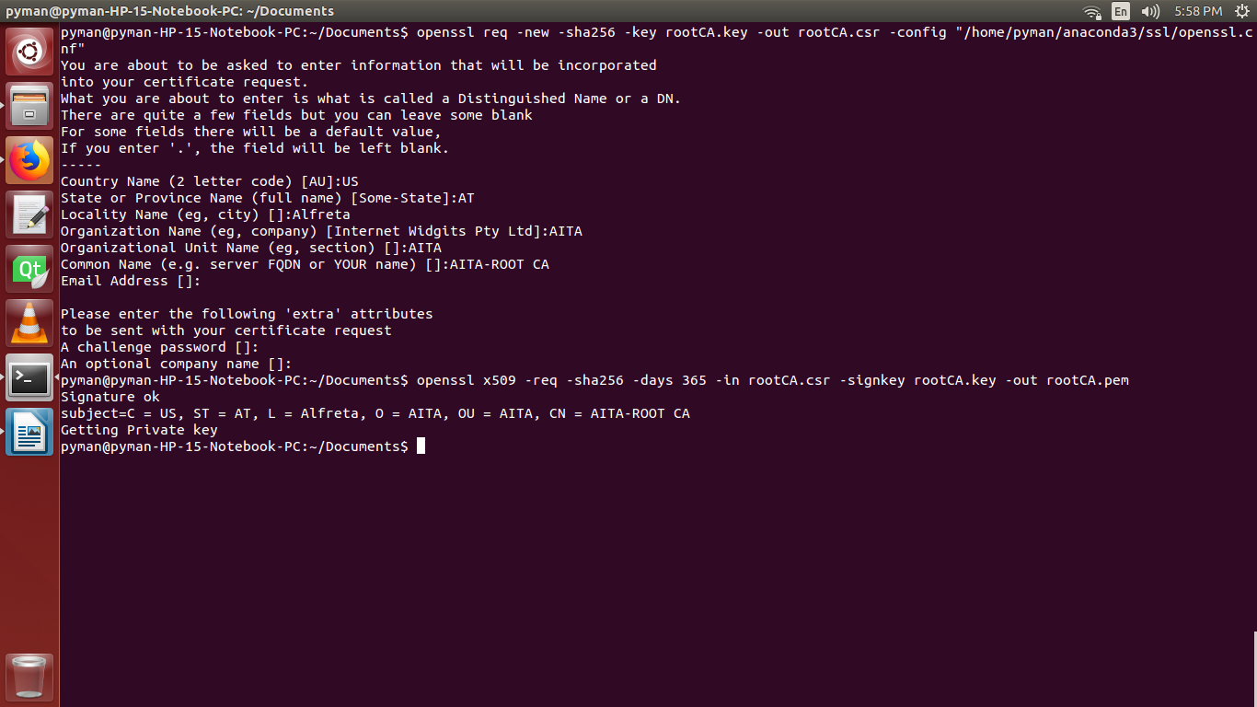
Root CA Creation:
Create csr (Certificate Signing Request)
Self-Sign the csr file and create certificate

Slide 13
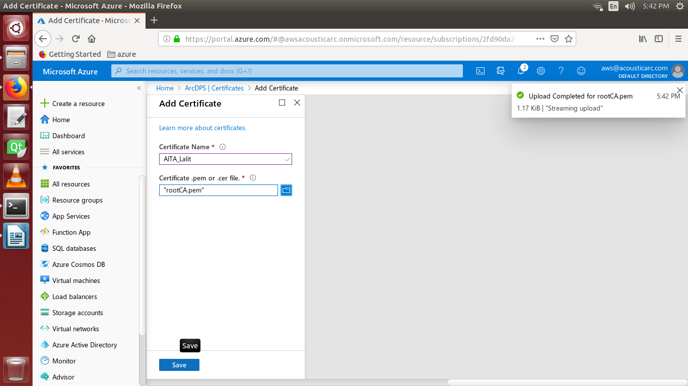
Upload and Verify root CA in Azure Device Provisioning Service (DPS):
Upload Root Certificate
Open the DPS.
Click on certificates.
Add Certificate.
Upload the root certificate rootCA.pem
The status of the certificate will be Unverified.

Slide 14
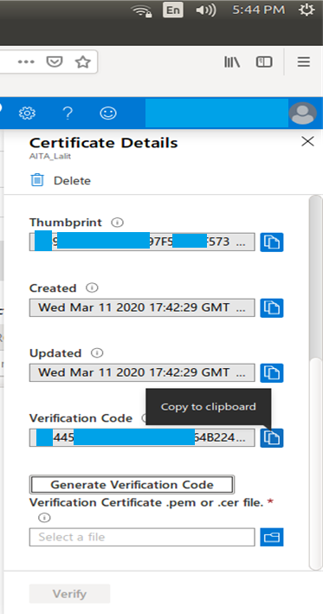
Verify root CA:
Click on the certificate, a tab will be opened details the certificate.
Click on ‘Generate Verification Code.
Run following command to create a possession (verification) certificate.
openssl genrsa -out verify.key 2048
openssl req -new -sha256 -key verify.key -out verify.csr
Note : If you are using a Win OS add this line after the above command -config “/path of your openSSL config.cnf file"
Copy the Verification code generated from azure and
paste as Common Name.
openssl x509 -req -in verify.csr -CA rootCA.pem -CAkey rootCA.key
-CAcreateserial -out verify.pem -days 365 -sha256
Select the verify.pem and click verify.

Slide 15
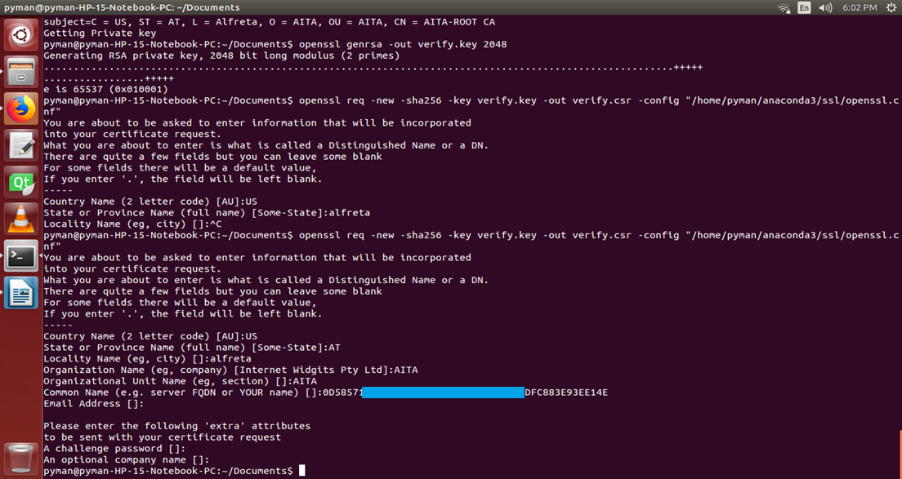
Verify root CA:

Slide 16
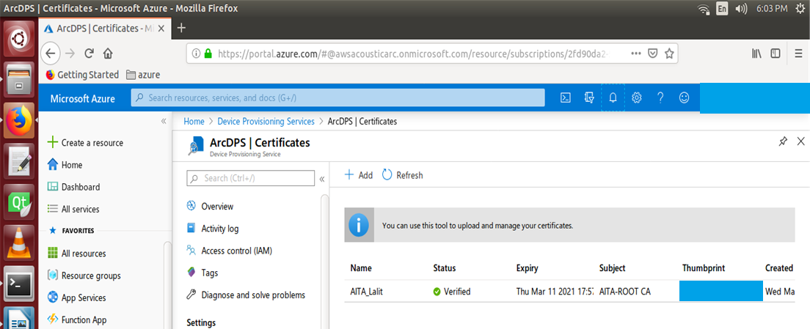
Verify root CA:
Verify root CA

Slide 17
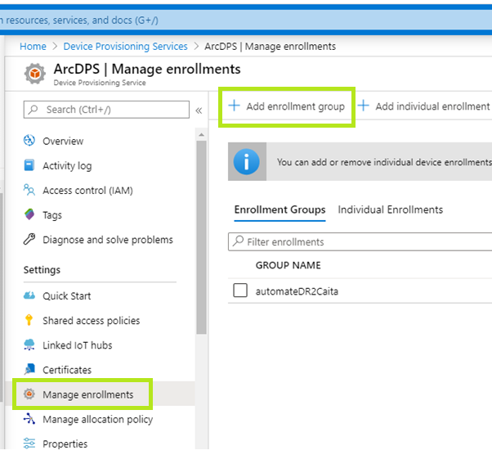
Manage Enrollment:
Create Enrollment group
Open manage enrollment and add enrollment group.
Give name for group

Slide 18
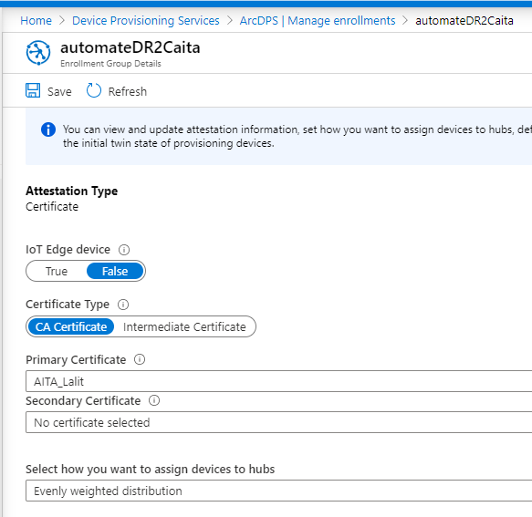
Manage Enrollment:
Select certificate type as ‘CA Certificate’
Select primary certificate (select the root CA already created from the list)

Slide 19
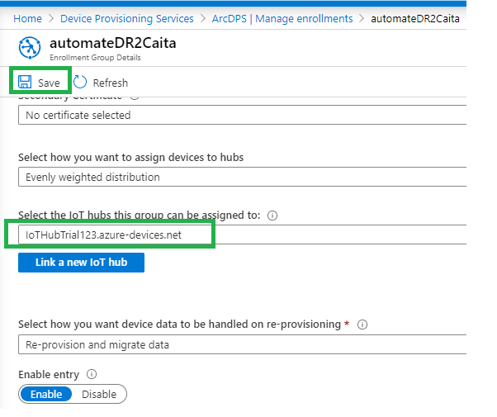
Manage Enrollment:
Link the enrollment with an IoT hub and save

Slide 20
Create and Sign device certificate:
Create device Certificate Signing Request using openssl tool
Create device private key
openssl genrsa -out device.key 2048
Create device CSR file. Give device serial number/device ID as common name while applying following commad
openssl req -new -sha256 -key device.key -out device.csr
Note : If you are using a Win OS add this line after the above command -config “/path of your openSSL config.cnf file"
Sign the device csr and generate certificate
Sign the device CSR using root certificate and private key
openssl x509 -req -in device.csr -CA rootCA.pem -CAkey rootCA.key -CAcreateserial -out device.pem -days 365 -sha256

Slide 21
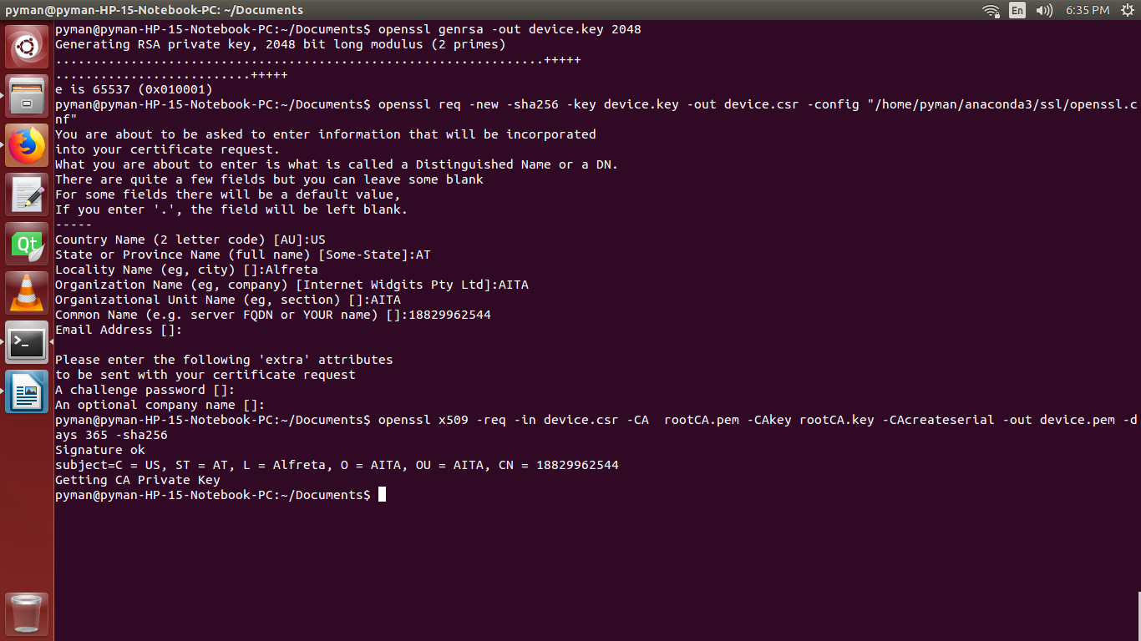
Create and Sign device certificate:
Create device private key
Create device CSR file
device serial number/device ID as common name
Sign the device csr and generate certificate

Slide 22
Azure iot-hub client for python:
https://github.com/Azure/azure-sdk-for-python click on this link and setup the SDK for Azure iot-hub.
Or you can use pip install command to install python package:
$ pip install azure-iothub-device-client

Slide 23
Example Script :
https://github.com/Azure/azure-iot-sdk-python/tree/master/azure-iot-device/samples/sync-samples
you can find all python example Script at this link.

Slide 24

AWS - Device Provisioning and connect a Device to iot-core

Slide 25
Prerequisite :
Python 3X and pip package.
SSH and OpenSSL basic.
Basic understanding of Cloud.
Basic Understanding of IOT.
AWS Cloud login credentials.

Slide 26
Create RootCA :
win user open CMD paste the comamnd.(make sure you have installed openssl for win)
ubuntu user: open terminal and paste the comamnd.
$openssl genrsa -out rootCA.key 2048
$openssl req -x509 -new -nodes -key rootCA.key -sha256 -days 1024 -out rootCA.pem -subj "/C=CN/ST=GZ/L=SZ/O=axi/CN=123456789"
You change your details in : subj

Slide 27
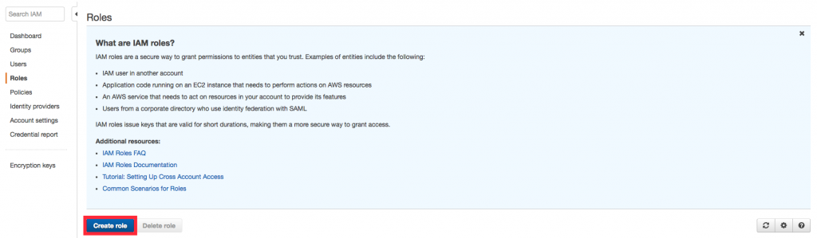
Go to aws console and create a role

Slide 28
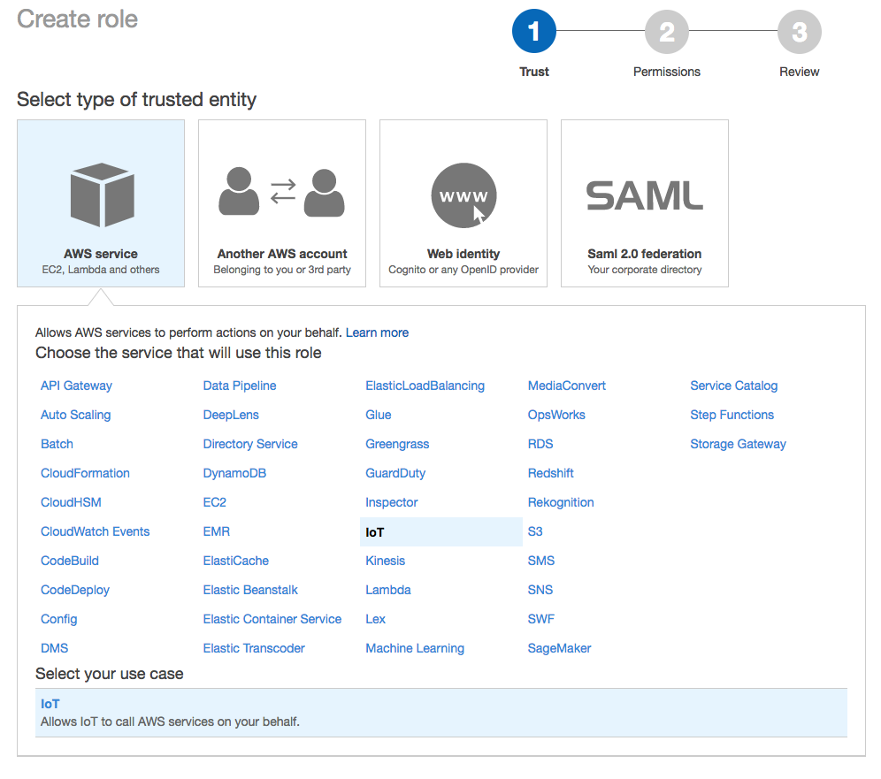
And select iot

Slide 29
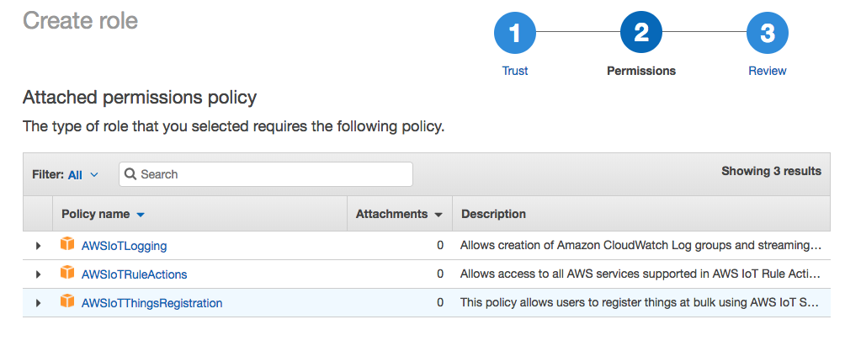
it’s should be looks like this

Slide 30
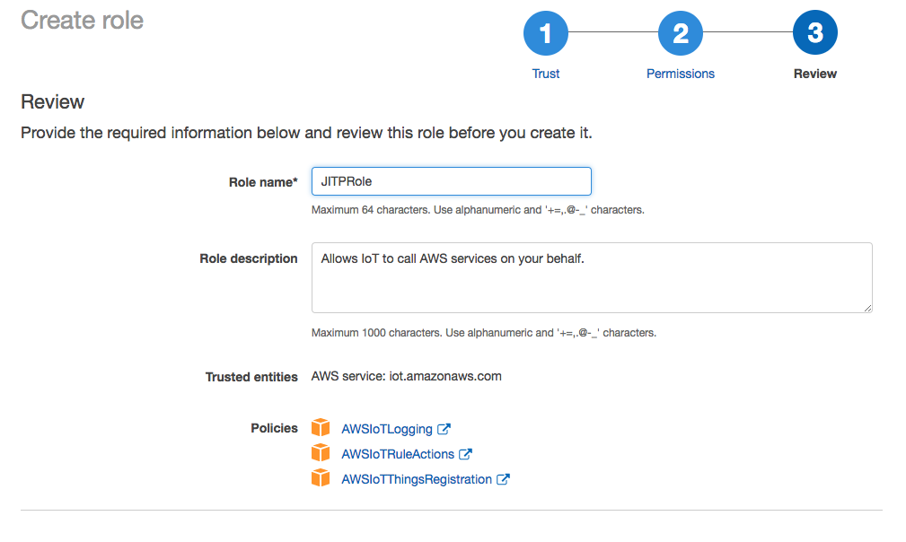
And than create role and give a description whatever you want.

Slide 31
Create a “provisioning-template.json” file
$Nano provisioning-template.json
And paste this json data into or
You change accordingly your use

Slide 32
AWS API call
aws iot get-registration-code return value is comman name
openssl genrsa -out verificationCert.key 2048
openssl req -new -key verificationCert.key -out verificationCert.csr
Country Name (2 letter code) [AU]:
State or Province Name (full name) []:
Locality Name (for example, city) []:
Organization Name (for example, company) []:
Organizational Unit Name (for example, section) []:
Common Name (e.g. server FQDN or YOUR name) []: XXXXXXXREGISTRATION-CODEXXXXXXX
Email Address []:

Slide 33
Register our policy doc to aws iot-core
openssl x509 -req -in verificationCert.csr -CA rootCA.pem -CAkey rootCA.key -CAcreateserial -out verificationCert.pem -days 500 -sha256
aws iot register-ca-certificate --ca-certificate file://rootCA.pem --verification-cert file://verificationCert.pem --set-as-active --allow-auto-registration --registration-config file://provisioning-template.json

Slide 34
Create device cret
openssl genrsa -out deviceCert.key 2048
openssl req -new -key deviceCert.key -out deviceCert.csr
openssl x509 -req -in deviceCert.csr -CA rootCA.pem -CAkey rootCA.key -CAcreateserial -out deviceCert.crt -days 365 -sha256
cat deviceCert.crt rootCA.pem > deviceCertAndCACert.crt

Slide 35
Test with moqute mqqt
mosquitto_pub --cafile root.cert --cert deviceCertAndCACert.crt --key deviceCert.key -h <prefix>.iot.us-east-1.amazonaws.com -p 8883 -q 1 -t foo/bar -I anyclientID --tls-version tlsv1.2 -m "Hello" –d
use this command to find your prefix of aws account:
aws iot describe-endpoint
you can find all script are here: click me

Slide 36
Thanks to being with me Stay Awesome

